Slide 1
QBNN: Quantum Binary Neural Network
Divye Jain, Harsh Patwari, Jack Khuu

Slide 2
What is a QBNN?
Binary Neural Network implemented in quantum space
What is a BNN? [1]
Neural network where the weights and activation are binary at runtime (i.e 0/1, -1/1)

Slide 3
Why BNN?
Reduces the amount of space needed for representation [1]
Allows many arithmetic operations to be bit operations [1]

Slide 4
Why quantum?
Potential improvement/speed up by replacing established classical components with quantum implementations
Opens new avenues for algorithms that would be unreasonable in classical computing

Slide 5
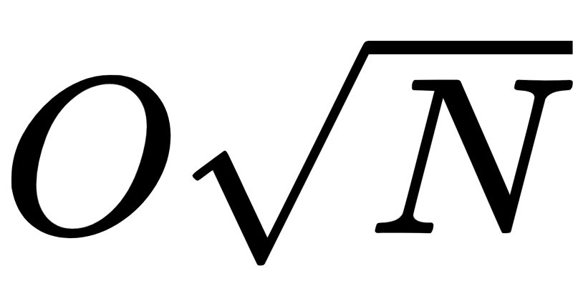
Grover's Algorithm [2]
Linear searching with near unary accuracy in sub-linear time
Well established framework for adaption

Slide 6
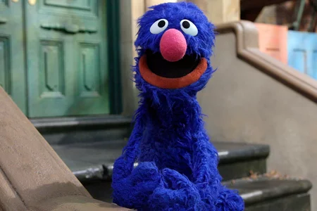
Grover's Algorithm [2]
1 - Uniform Superposition
2 - Marking Desired States
3 - Reflect/Amplify
4 - Measure
https://people.com/tv/viral-video-grover-dropping-f-bomb-on-sesame-street-what-do-you-hear/

Slide 7
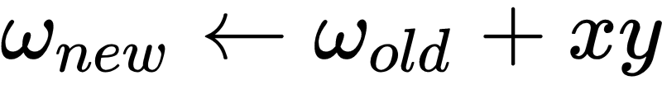
Method 1: Grover Search over data [3]
Search for data points (x, y) that are misclassified and that will update weights for each nodes
For example in classical perceptron, for misclassified input (x, y):

Slide 8
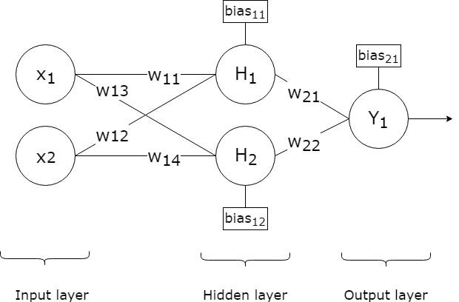
Method 1: Grover Search over data [3]
In a neural network:

Slide 9
Method 2: Grover Search for hyperplane [3]
Instead of finding data to update weights, just find the weights themselves
Search for a set of weights/hyperplane that separates the data (x, y)

Slide 10
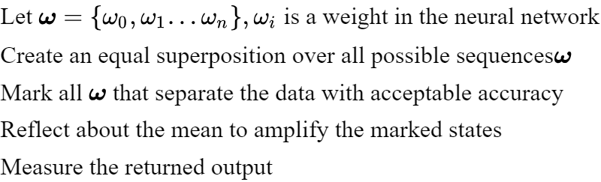
Grover's for Version Space Search
Let w = {w₀, w₁, …. w_{n}}, where w_{i} is a weight in the neural network.
Create an equal superposition over all possible sequences w
Mark all w that separates the data with acceptable accuracy
Reflect about the mean to amplify the marked states
Measure the returned output

Slide 11
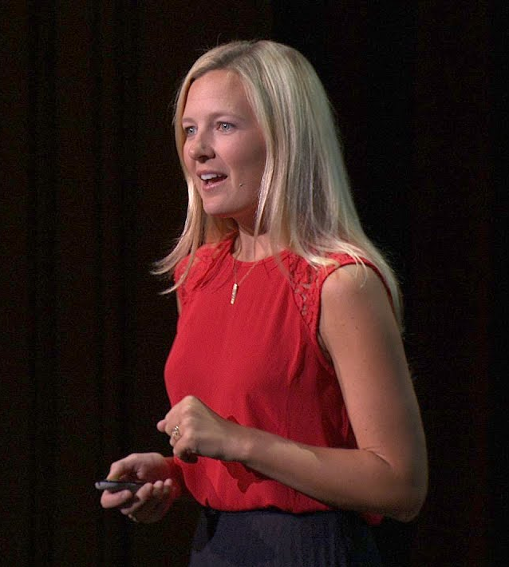

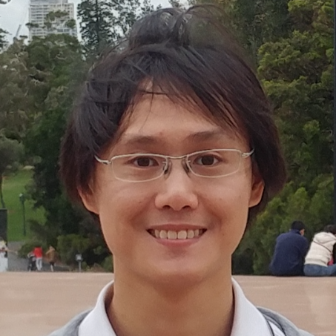
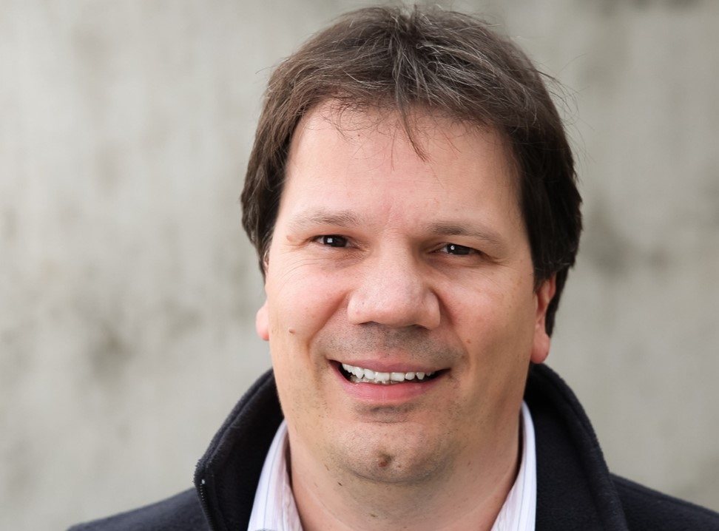
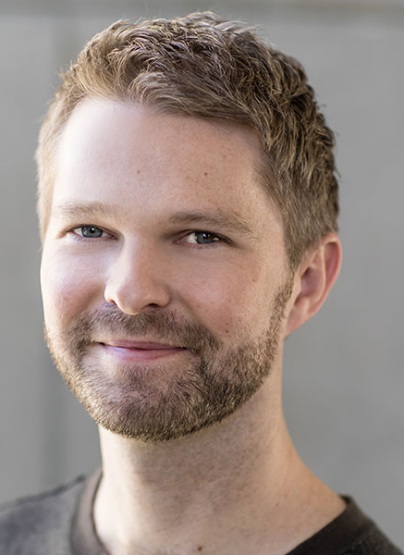

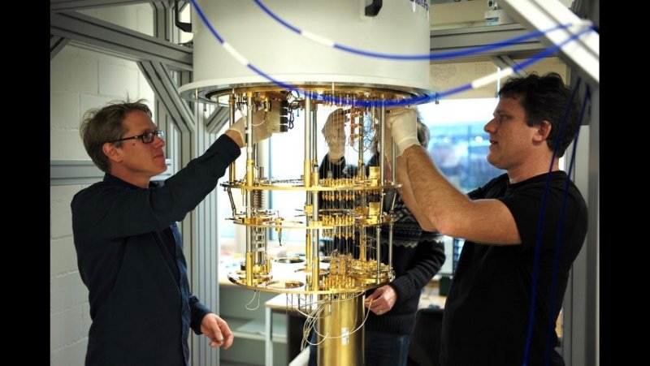

Slide 12
Grover's for Version Space Search
Let w = {w₀, w₁, …. w_{n}}, where w_{i} is a weight in the neural network.
Create an equal superposition over all possible sequences w
Mark all w that separates the data with acceptable accuracy
Reflect about the mean to amplify the marked states
Measure the returned output

Slide 13
Marking Oracle
After creating a superposition over all states of the weight, the algorithm needs to mark all of the “correct weights”.

Slide 14
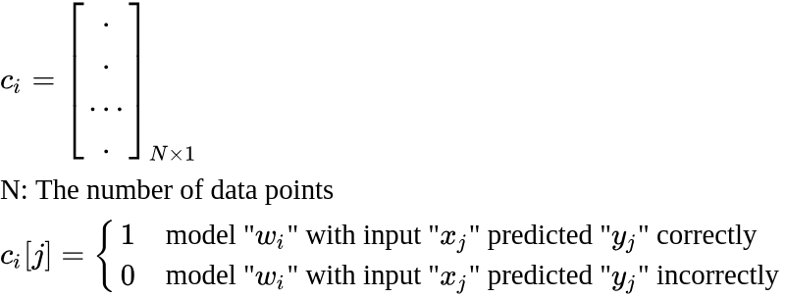



Overview: Marking Oracle
Marking Oracle:
Input: Qubit[]
target: Qubit
Quantum Magic
Mark the target if “c” has at-least “acc”% of 1s
So if desired accuracy is 80% -> Flip target if “c” has at-least 80% 1s
Undo Quantum Magic

Slide 15
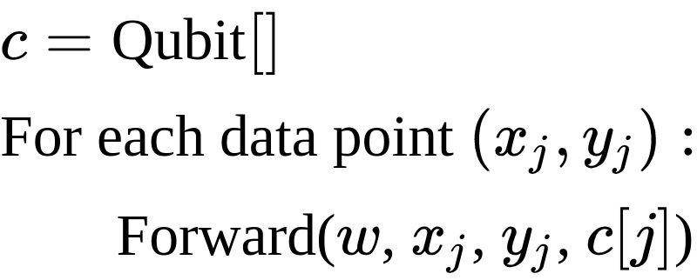
Quantum Magic
“Forward”: Our implementation of the BNN (Binary Neural Nets) forward pass with Quantum operators

Slide 16
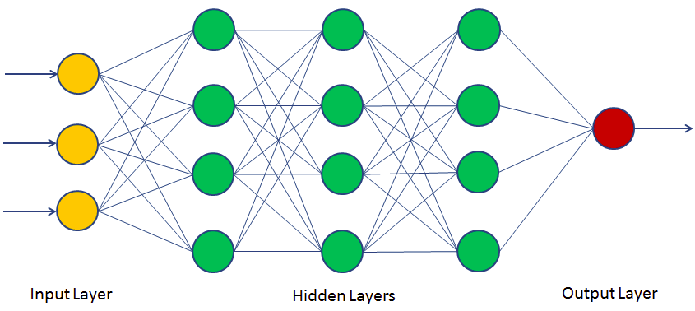
Neural Net: Recap

Slide 17
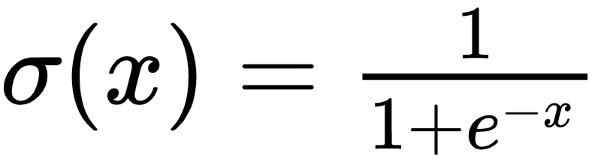
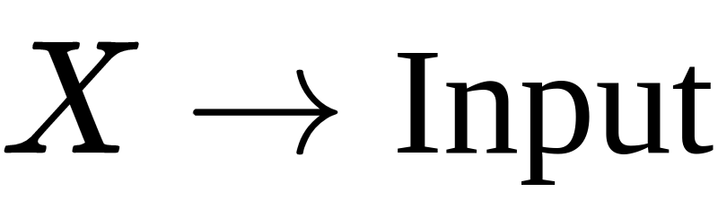
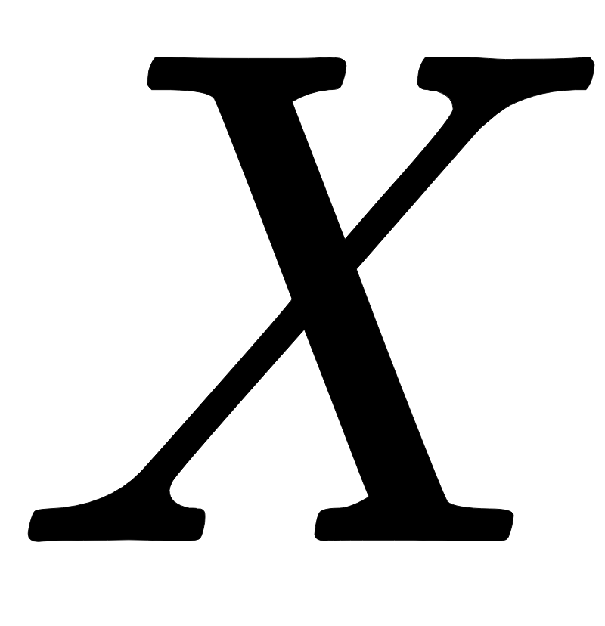

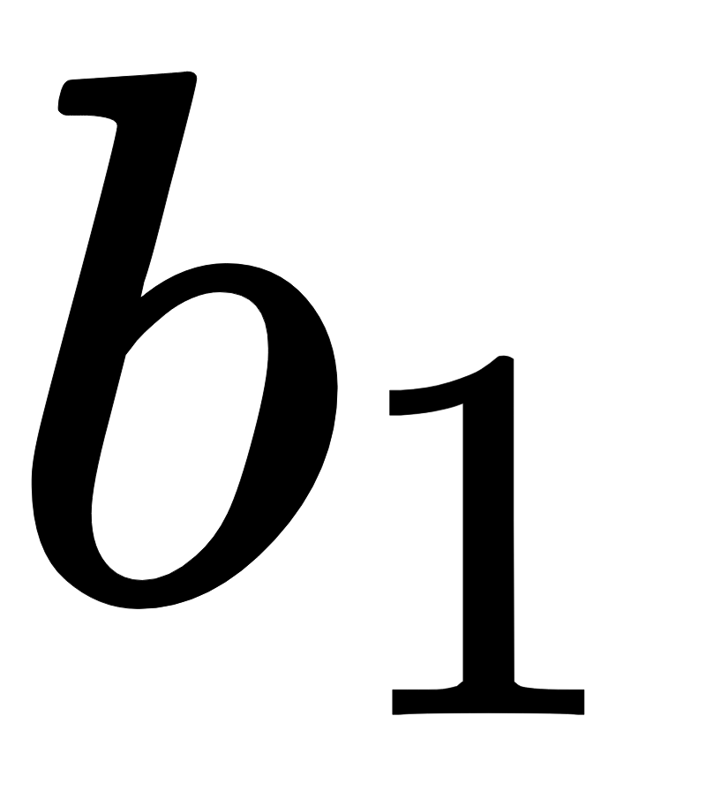
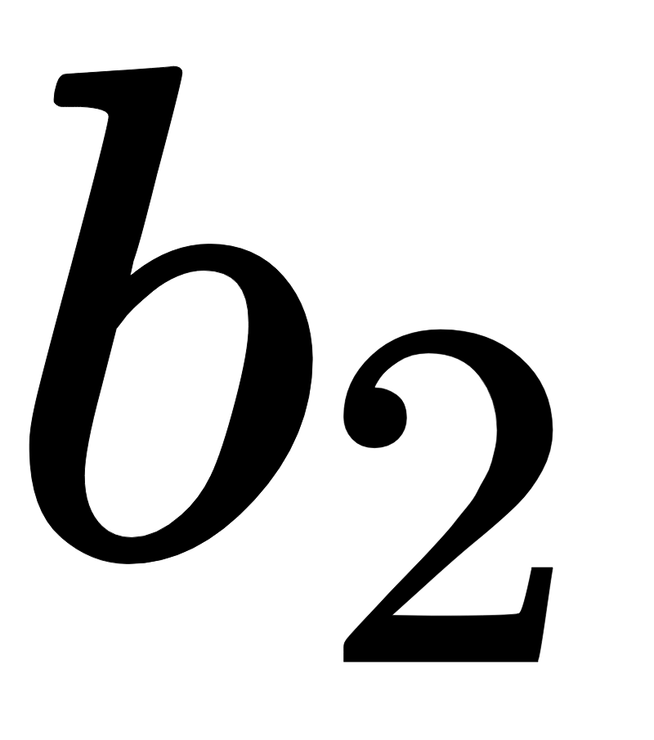
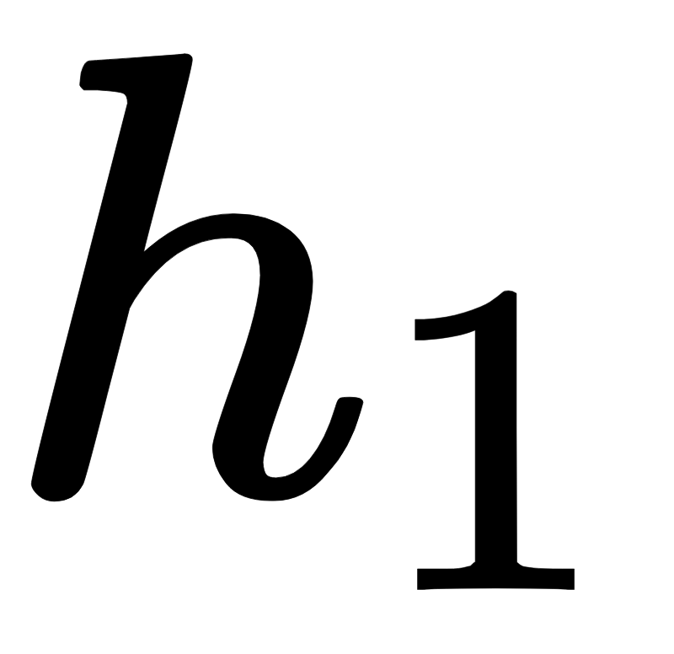
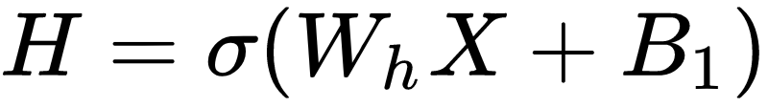
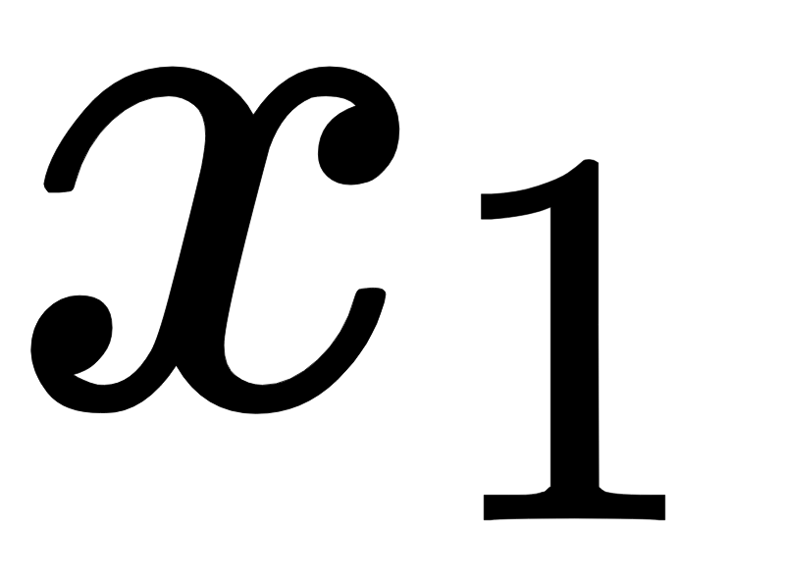
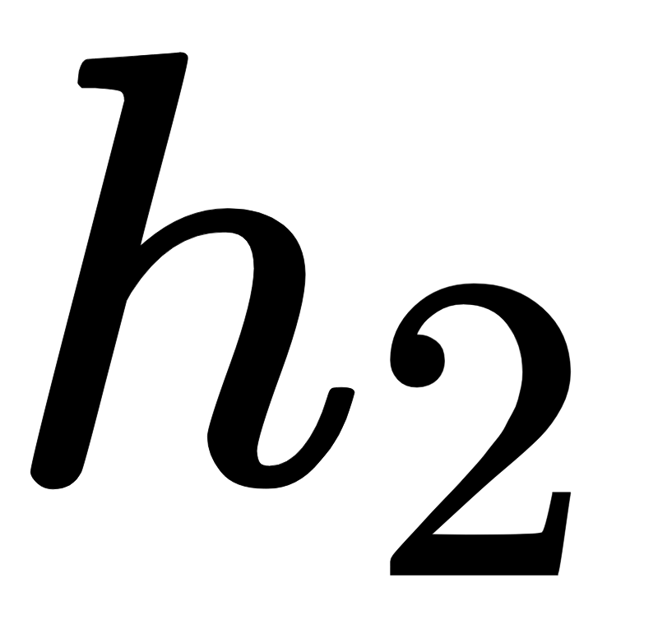
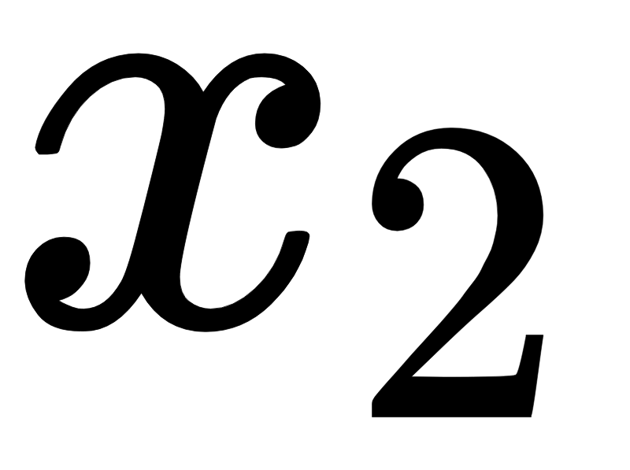
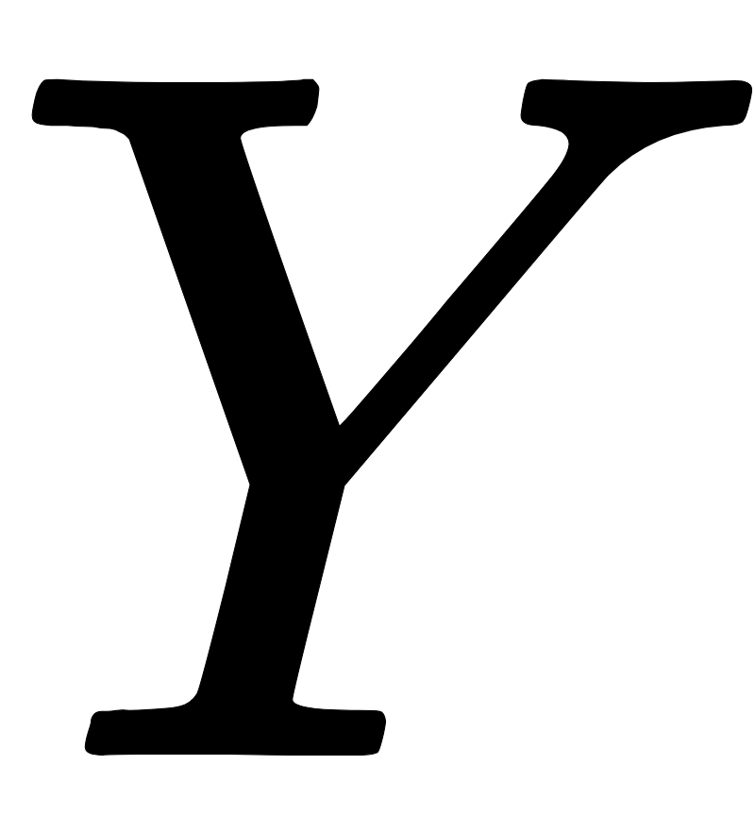
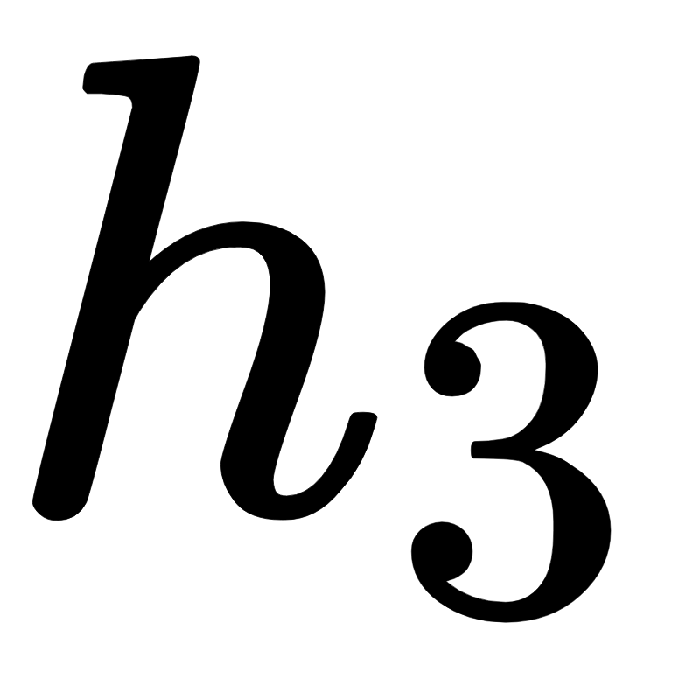
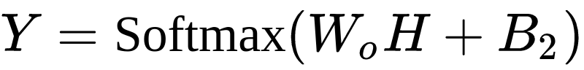
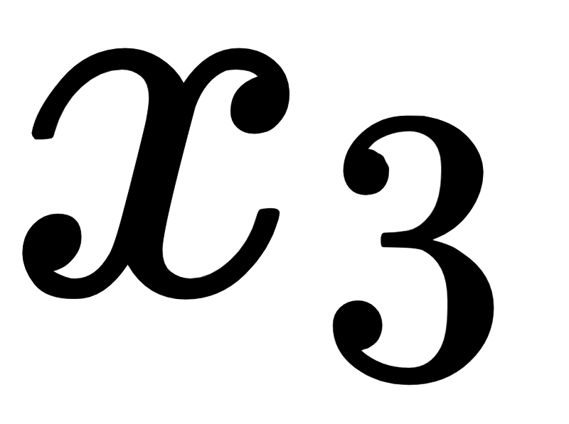
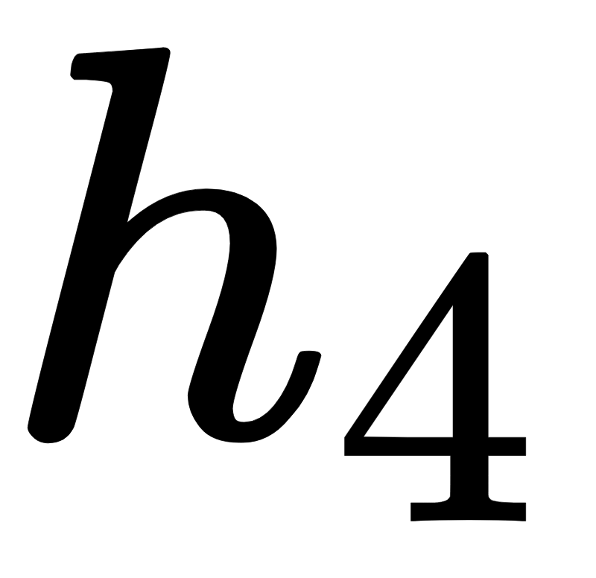
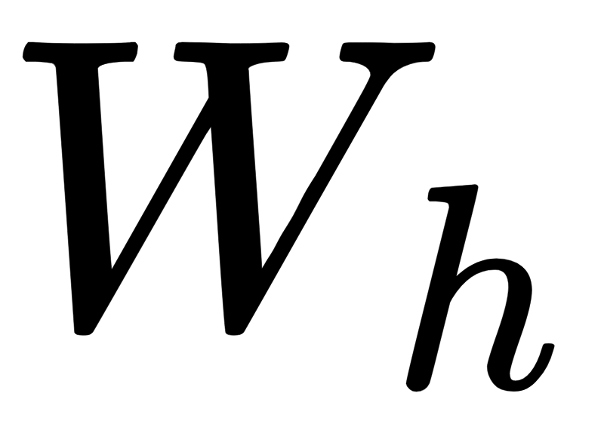
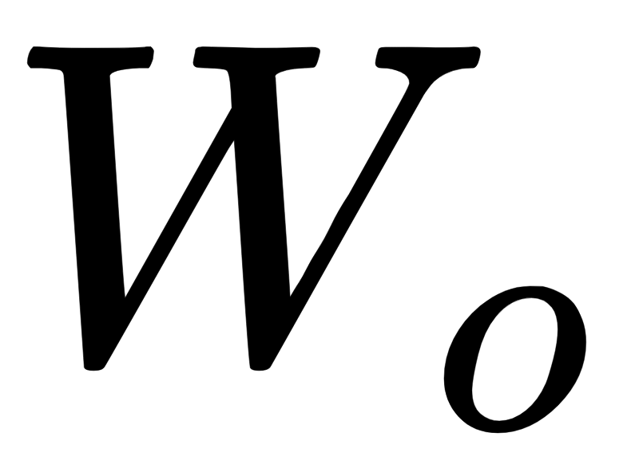
How does a forward pass work?

Slide 18
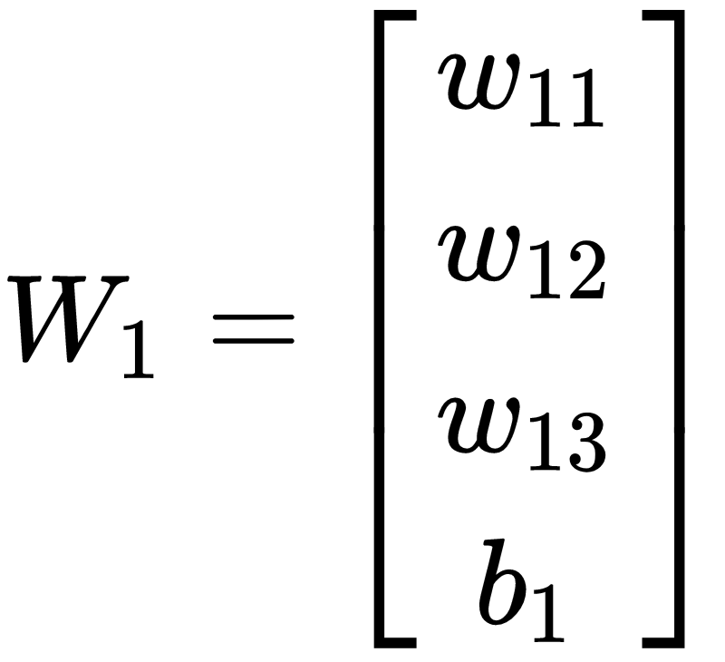
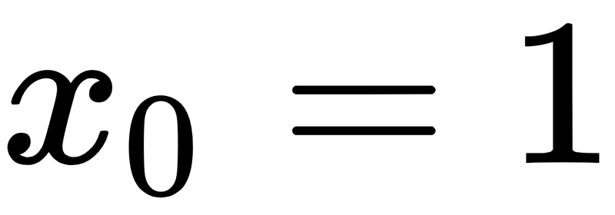
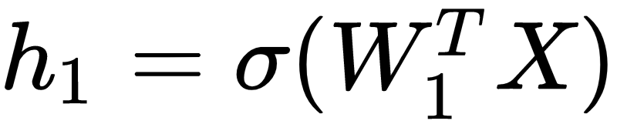

More Specifically

Slide 19
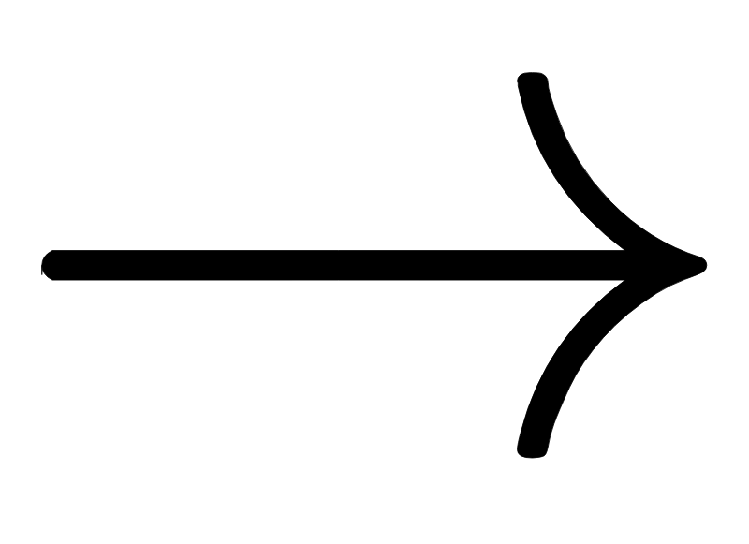


In our binary case
All weights and inputs are binary (+1 and -1)
The activation function is the “sign function”

Slide 20
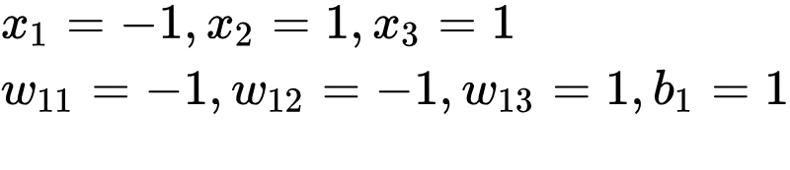

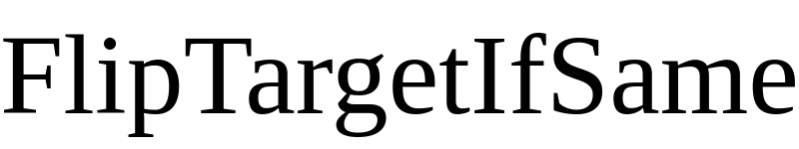
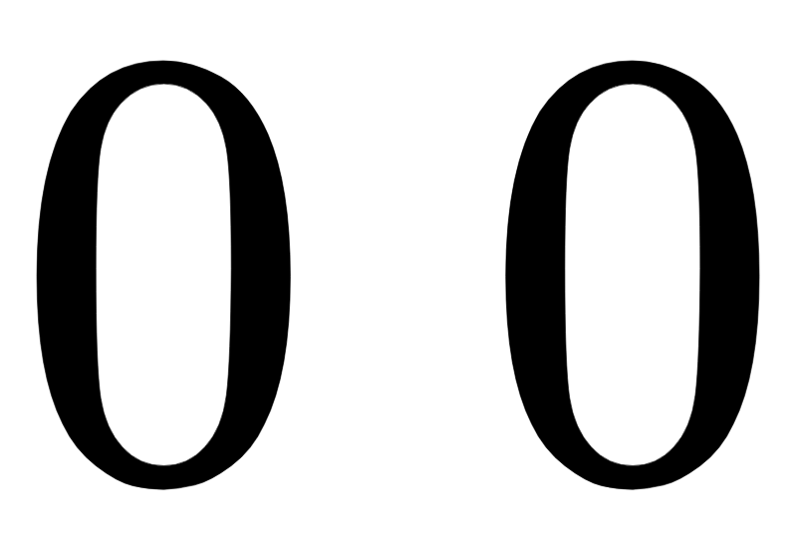
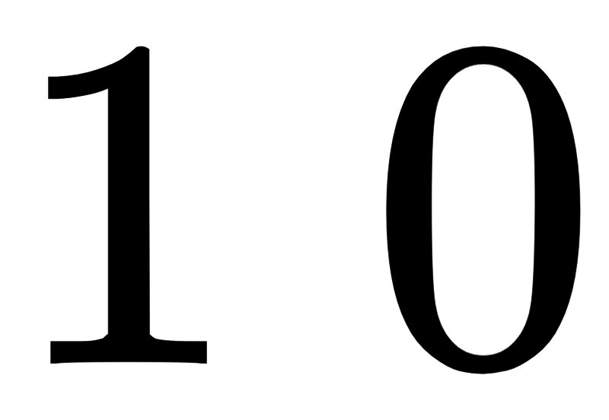
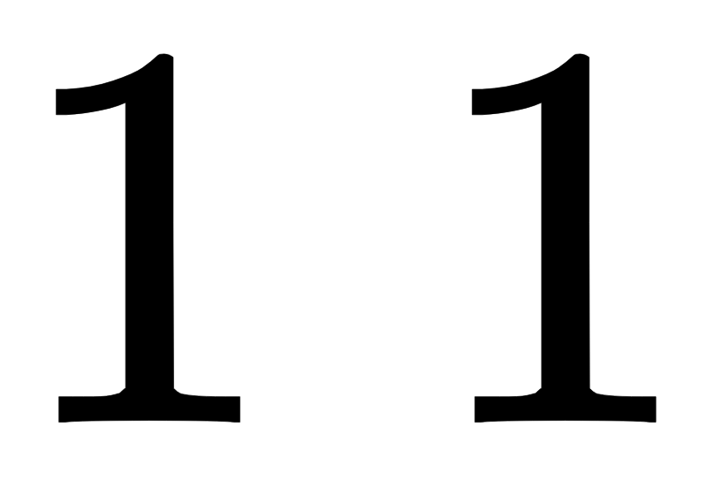


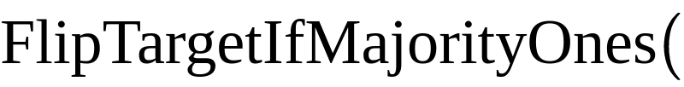



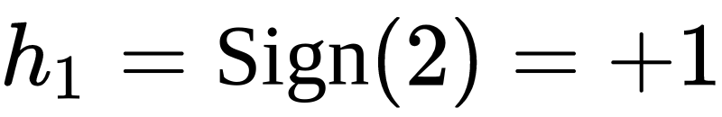
How to do it with Quanum Operators

Slide 21

How to do the entire forward pass in Quantum?
We just saw how we can do it for one node
Repeat the process for each node in the entire layer
Now, we can use RECURSION
output of one layer input to the other
Final layer output Mark “c[j]” if the output is the same as y[j]

Slide 22
Quantum Magic
“Forward”: Our implementation of the BNN (Binary Neural Nets) forward pass with Quantum operators

Slide 23
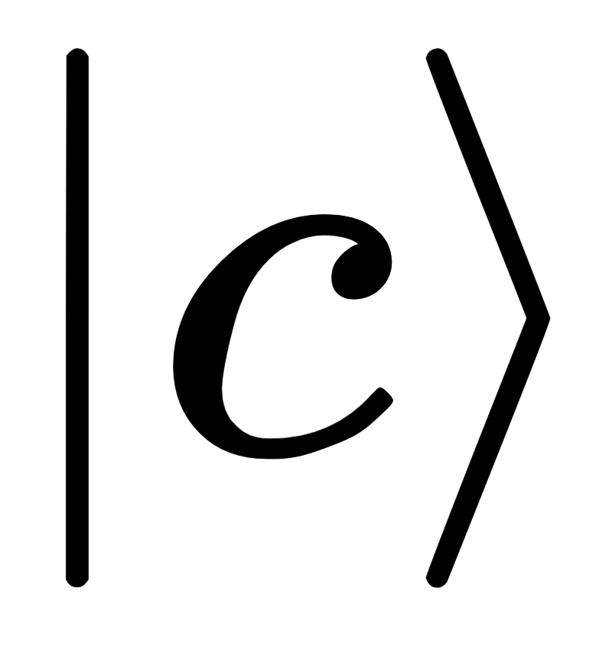
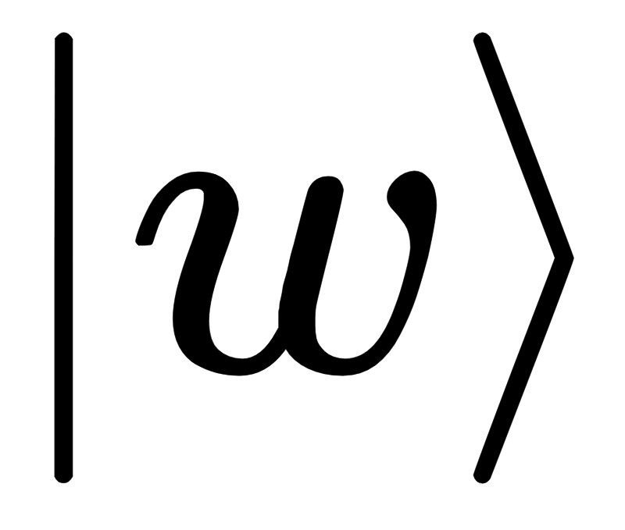
Final Marking Oracle
Marking Oracle:
Input: Qubit[]
target: Qubit
Entangle with by marking c[j] bit 1 if the output of the "forward pass" (from x[j]) matches the true output (y[j])
Mark the target if “c” has at-least “acc”% of 1s
So if desired accuracy is 80% -> Flip target if “c” has at-least 80% 1s
Un-Entangle with by marking c[j] bit 1 if the output of the "forward pass" (from x[j]) matches the true output (y[j])

Slide 24
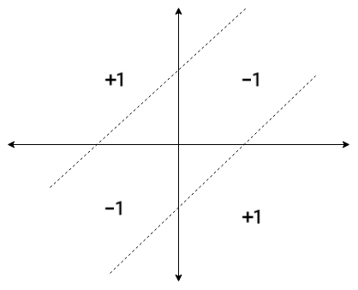
Resources required
Let us take the example of the circuit for the XNOR gate:
XNOR is a simple example of a circuit that cannot be predicted with a classical single layer perceptron

Slide 25

Resources required
Let us take the example of the circuit for the XNOR gate:
Total number of qubits required = 40

Slide 26
Resources required
Let us take the example of the circuit for the XNOR gate:
# data points = 4, # features = 2 # true labels = 4
# qubits to represent the input = (4 x 2) + 4 = 12 # predicted labels = 4 # qubits to represent the weights including the bias = 9 Total = 25

Slide 27
Resources required
Let us take the example of the circuit for the XNOR gate:
Total number of qubits required by adder = (3 x (log₂4 + 3)) = 15

Slide 28
Optimizations
Process inputs in batches
In this case, process a single data point and a single label at a time.
# data points / batch = 1, # features = 2 # true labels / batch = 1
# qubits to represent the input = (1 x 2) + 1 = 3

Slide 29
Optimizations
Use recursion to replace adder
We use the adder for computing the majority and to check if the choice of weights gives us the desired accuracy.
Using a recursive approach to create a boolean array and do a ControlledOnBitString operation saves us 15 qubits.

Slide 30
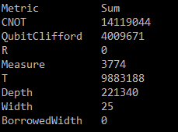
Optimizations
Total number of qubits required after optimization = 25

Slide 31
Demo

Slide 32
Impact
We can potentially create any random quantum circuit, given just the input and the expected output
Our network doesn’t need to be differential!! Since we are no longer doing back prop

Slide 33
Works Cited
[1] Courbariaux, Matthieu and Bengio, Yoshua. Binarynet: Training deep neural networks with weights and activations constrained to+ 1 or-1. arXiv preprint arXiv:1602.02830, 2016.
[2] Figgatt, C. et al. Complete 3-qubit grover search on a programmable quantum computer. Preprint at https://arxiv.org/abs/1703.10535 (2017)
[3] Wiebe, N., Kapoor, A. & Svore, K. M. Quantum perceptron models. Adv. Neural Inform. Process. Syst. 29, 3999–4007 (2016)
[4] John and Jakub for the QFT Adder :D

Slide 34

Thank You
Questions? Comments? T-shirts?

